Slide 1
Human Activity Recognition
Edwin Candinegara

Slide 2
Objectives
Real-time Smartphone based Human Activity Recognition
Smartwatch based Human Activity Recognition
Notes:
= Data collection process → documentation
= Activity description
Versus available data currentls

Slide 3
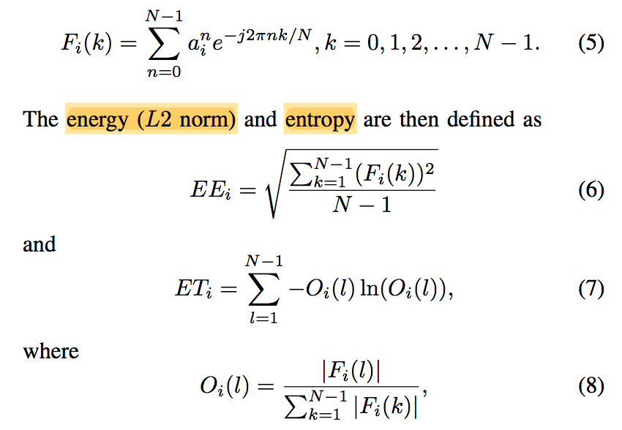

Features
Mean
$a_{x},a_{y},a_{z},a_{mag}$
Variance
$a_{x},a_{y},a_{z},a_{mag}$
Energy
$a_{x},a_{y},a_{z},a_{mag}$
Entropy
$a_{x},a_{y},a_{z},a_{mag}$
Correlation
$a_{xy},a_{xz},a_{xmag},a_{yz},a_{ymag},a_{zmag}$

Slide 4
Resolved Issues
Smartwatch application must be closed and reopened for every sampling session
This somehow prevents the jumping timestamp problem
Documented in the “data collection” documentation

Slide 5
Data Summary
Activities | Duration | Activities | Duration
Walking | 5 minutes | Typing (keyboard, sitting) | 5 minutes
Running | 6 minutes | Writing (pencil, sitting) | 5 minutes
Lying | 5 minutes | Reading (book, sitting) | 6 minutes
Sitting | 6 minutes | Eating (sitting) | 4.5 minutes
Standing | 6 minutes | Folding (clothes, standing) | 6 minutes
Going Upstairs | 6 minutes | Sweeping the Floor | 6 minutes
Going Downstairs | 6 minutes | Brushing (standing) | 6 minutes

Slide 6
Data Summary
10 Hz, 1s window size, half-overlapping: 8695 data points
Activities | Data Points | Activities | Duration
Walking | 578 | Typing (keyboard, sitting) | 518
Running | 674 | Writing (pencil, sitting) | 579
Lying | 518 | Reading (book, sitting) | 651
Sitting | 676 | Eating (sitting) | 516
Standing | 676 | Folding (clothes, standing) | 676
Going Upstairs | 645 | Sweeping the Floor | 676
Going Downstairs | 642 | Brushing (standing) | 670

Slide 7
Data Summary
10 Hz, 2s window size, half-overlapping: 4327 data points
Activities | Data Points | Activities | Duration
Walking | 288 | Typing (keyboard, sitting) | 258
Running | 336 | Writing (pencil, sitting) | 289
Lying | 258 | Reading (book, sitting) | 324
Sitting | 336 | Eating (sitting) | 257
Standing | 336 | Folding (clothes, standing) | 336
Going Upstairs | 321 | Sweeping the Floor | 336
Going Downstairs | 318 | Brushing (standing) | 334

Slide 8
Data Summary
10 Hz, 3s window size, half-overlapping: 2875 data points
Activities | Data Points | Activities | Duration
Walking | 192 | Typing (keyboard, sitting) | 172
Running | 222 | Writing (pencil, sitting) | 192
Lying | 172 | Reading (book, sitting) | 213
Sitting | 224 | Eating (sitting) | 171
Standing | 224 | Folding (clothes, standing) | 224
Going Upstairs | 213 | Sweeping the Floor | 224
Going Downstairs | 210 | Brushing (standing) | 222

Slide 9
Results
Experiments (5-folds, 70-30 train-test split ratio):
SVM
Random Forest

Slide 10
Random Forest
Number of estimators = 10
The bigger the window size, the better it is!
Sampling Frequency | Window Size | Accuracy Mean (SP + SW) | Accuracy Mean (SP) | Accuracy Mean (SW)
10 Hz | 1 second | 95.53% | 89.8% | 89.72%
10 Hz | 2 seconds | 96.51% | 92% | 92.51%
10 Hz | 3 seconds | 98.19% | 93.4% | 94.78%

Slide 11
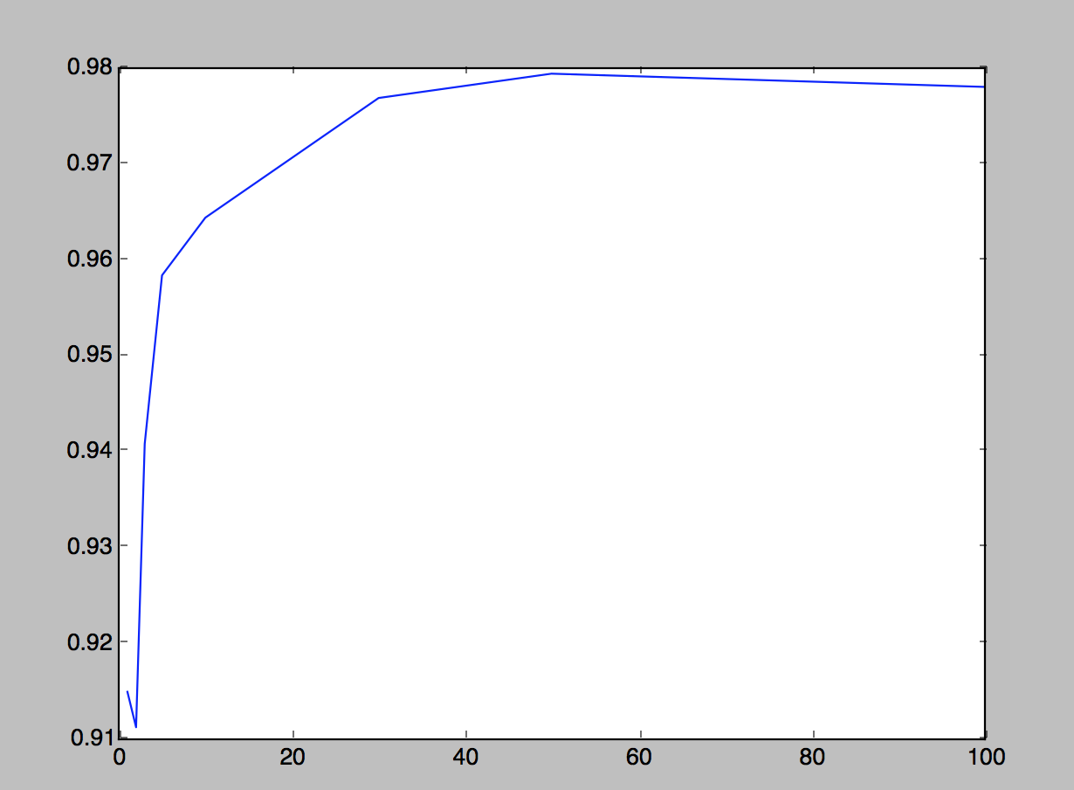
Random Forest
Sampling frequency = 10 Hz
Window size = 2s
Above 50 estimators, it seems it is overfitting the training data

Slide 12
SVM
C = 10, kernel = RBF
The bigger the window size, the better it is!
Sampling Frequency | Window Size | Accuracy Mean (SP + SW) | Accuracy Mean (SP) | Accuracy Mean (SW)
10 Hz | 1 second | 94.39% | 79.25% | 82.10%
10 Hz | 2 seconds | 96.33% | 82.92% | 86.67%
10 Hz | 3 seconds | 96.87% | 85.88% | 87.17%

Slide 13
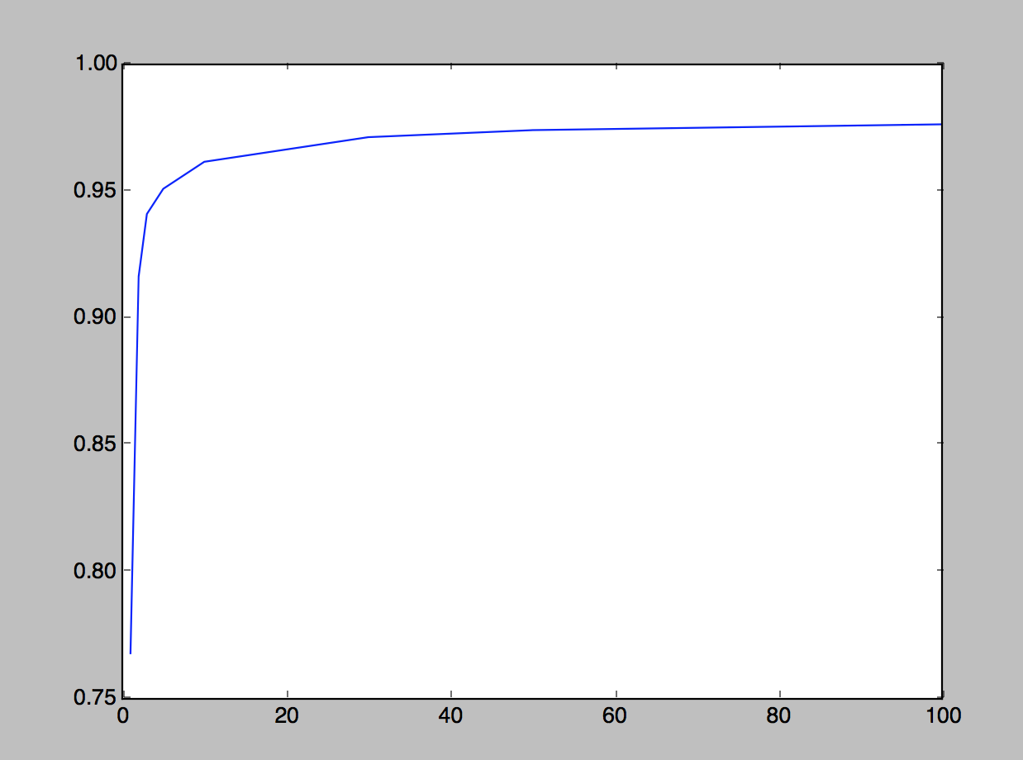
SVM (Smartphone + Smartwatch)
Sampling frequency = 10 Hz
Window size = 2s
Kernel = RBF
The bigger the cost is, the better it is!

Slide 14
Observations
Random Forest has better performance in general compared to SVM
RF has higher accuracy even when we are only using the Smartphone or Smartwatch data alone
The performance of the models trained only with Smartwatch data is better than if it is trained only with Smartphone data
This may be because most of the activities examined put more focus on the hand movements

Slide 15
What’s next?
Try other models:
HMM (still looking for a good implementation in Python)
Naive Bayes
RBM
MLP
Gather friends’ data (?)

